Slide 1
Inheritance

Slide 2
Inheritance in Java is a mechanism in which one object acquires all the properties and behaviors of a parent object. It is an important part of OOPs. Inheritance represents the IS-A relationship which is also known as a parent-child relationship.
Why use inheritance in java
For Method Overriding (so runtime polymorphism can be achieved).
For Code Reusability.

Slide 3
The syntax of Java Inheritance
class Subclass-name extends Superclass-name
{
//methods and fields
}
The extends keyword indicates that you are making a new class that derives from an existing class. The meaning of "extends" is to increase the functionality.
In the terminology of Java, a class which is inherited is called a parent or superclass, and the new class is called child or subclass.

Slide 4
class Employee{
float salary=40000;
}
class Programmer extends Employee{
int bonus=10000;
public static void main(String args[]){
Programmer p=new Programmer();
System.out.println("Programmer salary is:"+p.salary);
System.out.println("Bonus of Programmer is:"+p.bonus);
}
}

Slide 5
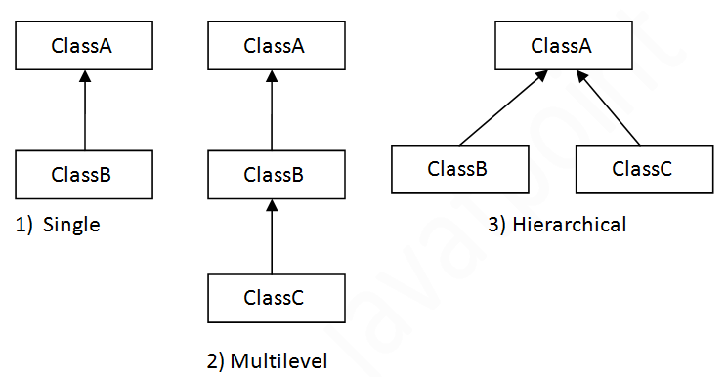
Types of inheritance in java
On the basis of class, there can be three types of inheritance in java: single, multilevel and hierarchical.
In java programming, multiple and hybrid inheritance is supported through interface only.

Slide 6
Multilevel Inheritance Example
class Animal{
void eat(){System.out.println("eating...");}
}
class Dog extends Animal{
void bark(){System.out.println("barking...");}
}
class BabyDog extends Dog{
void weep(){System.out.println("weeping...");}
}
class TestInheritance2{
public static void main(String args[]){
BabyDog d=new BabyDog();
d.weep();
d.bark();
d.eat();
}}

Slide 7
Hierarchical Inheritance Example
class Animal{
void eat(){System.out.println("eating...");}
}
class Dog extends Animal{
void bark(){System.out.println("barking...");}
}
class Cat extends Animal{
void meow(){System.out.println("meowing...");}
}
class TestInheritance3{
public static void main(String args[]){
Cat c=new Cat();
c.meow();
c.eat();
//c.bark();//C.T.Error
}}

Slide 8
Why multiple inheritance is not supported in java?
To reduce the complexity and simplify the language, multiple inheritance is not supported in java.
Consider a scenario where A, B, and C are three classes. The C class inherits A and B classes. If A and B classes have the same method and you call it from child class object, there will be ambiguity to call the method of A or B class.
Since compile-time errors are better than runtime errors, Java renders compile-time error if you inherit 2 classes. So whether you have same method or different, there will be compile time error.

Slide 9
Multiple inheritance
class A{
void msg(){System.out.println("Hello");}
}
class B{
void msg(){System.out.println("Welcome");}
}
class C extends A,B{//suppose if it were
public static void main(String args[]){
C obj=new C();
obj.msg();//Now which msg() method would be invoked?
}
}

Slide 10
Method Overriding in Java
If subclass (child class) has the same method as declared in the parent class, it is known as method overriding in Java.
In other words, If a subclass provides the specific implementation of the method that has been declared by one of its parent class, it is known as method overriding.
Usage of Java Method Overriding
Method overriding is used to provide the specific implementation of a method which is already provided by its superclass.
Method overriding is used for runtime polymorphism
Rules for Java Method Overriding
The method must have the same name as in the parent class
The method must have the same parameter as in the parent class.
There must have inheritance.

Slide 11
//Java Program to illustrate the use of Java Method Overriding
//Creating a parent class.
class Vehicle{
//defining a method
void run(){System.out.println("Vehicle is running");}
}
//Creating a child class
class Bike2 extends Vehicle{
//defining the same method as in the parent class
void run(){System.out.println("Bike is running safely");}
public static void main(String args[]){
Bike2 obj = new Bike2();//creating object
obj.run();//calling method
}
}

Slide 12
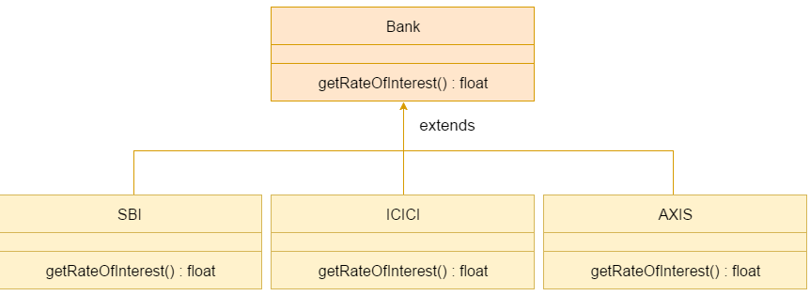
Example: method overrididng

Slide 13
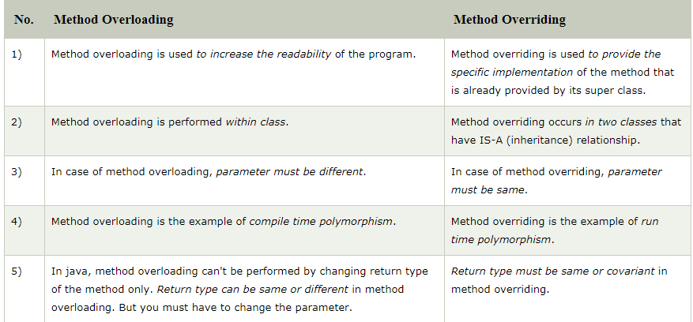
Difference between method overloading and method overriding in java

Slide 14
Super Keyword in Java
The super keyword in Java is a reference variable which is used to refer immediate parent class object.
Whenever you create the instance of subclass, an instance of parent class is created implicitly which is referred by super reference variable.
Usage of Java super Keyword
super can be used to refer immediate parent class instance variable.
super can be used to invoke immediate parent class method.
super() can be used to invoke immediate parent class constructor.

Slide 15
1) super is used to refer immediate parent class instance variable.
class Animal{
String color="white";
}
class Dog extends Animal{
String color="black";
void printColor(){
System.out.println(color);//prints color of Dog class
System.out.println(super.color);//prints color of Animal class
}
}
class TestSuper1{
public static void main(String args[]){
Dog d=new Dog();
d.printColor();
}}

Slide 16
2) super can be used to invoke parent class method
The super keyword can also be used to invoke parent class method. It should be used if subclass contains the same method as parent class. In other words, it is used if method is overridden.
class Animal{
void eat(){System.out.println("eating...");}
}
class Dog extends Animal{
void eat(){System.out.println("eating bread...");}
void bark(){System.out.println("barking...");}
void work(){
super.eat();
bark();
}
}
class TestSuper2{
public static void main(String args[]){
Dog d=new Dog();
d.work();
}}

Slide 17
3) super is used to invoke parent class constructor.
class Animal{
Animal(){System.out.println("animal is created");}
}
class Dog extends Animal{
Dog(){
super();
System.out.println("dog is created");
}
}
class TestSuper3{
public static void main(String args[]){
Dog d=new Dog();
}}

Slide 18
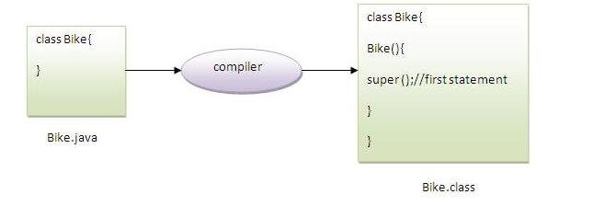
Note
super() is added in each class constructor automatically by compiler if there is no super() or this().
As we know well that default constructor is provided by compiler automatically if there is no constructor. But, it also adds super() as the first statement.

Slide 19
Final Keyword In Java
The final keyword in java is used to restrict the user. The java final keyword can be used in many context. Final can be:
variable
method
class
The final keyword can be applied with the variables, a final variable that have no value it is called blank final variable or uninitialized final variable. It can be initialized in the constructor only. The blank final variable can be static also which will be initialized in the static block only.

Slide 20
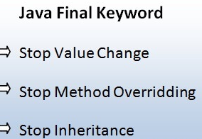
1) Java final variable
If you make any variable as final, you cannot change the value of final variable(It will be constant).

Slide 21
class Bike9{
final int speedlimit=90;//final variable
void run(){
speedlimit=400;
}
public static void main(String args[]){
Bike9 obj=new Bike9();
obj.run();
}
}//end of class

Slide 22
2) Java final method
If you make any method as final, you cannot override it.
Example of final method
class Bike{
final void run(){System.out.println("running");}
}
class Honda extends Bike{
void run(){System.out.println("running safely with 100kmph");}
public static void main(String args[]){
Honda honda= new Honda();
honda.run();
}
}

Slide 23
3) Java final class
If you make any class as final, you cannot extend it.
Example of final class
final class Bike{}
class Honda1 extends Bike{
void run(){System.out.println("running safely with 100kmph");}
public static void main(String args[]){
Honda1 honda= new Honda1();
honda.run();
}
}

Slide 24
Question
Q) Is final method inherited?
Q) Can we declare a constructor final?
What is final parameter?
If you declare any parameter as final, you cannot change the value of it.
class Bike11{
int cube(final int n){
n=n+2;//can't be changed as n is final
n*n*n;
}
public static void main(String args[]){
Bike11 b=new Bike11();
b.cube(5);
}
}

Slide 25
What is blank or uninitialized final variable?
A final variable that is not initialized at the time of declaration is known as blank final variable.
If you want to create a variable that is initialized at the time of creating object and once initialized may not be changed, it is useful. For example PAN CARD number of an employee.
It can be initialized only in constructor.
Que) Can we initialize blank final variable?
Yes, but only in constructor

